Slide 1
Membrane transport
Dr Tania Warnakulasuriya
Department of Physiology

Slide 2
Small non polar molecules ( O₂ and N₂) and small uncharged polar molecules diffuse across the lipid membranes of the cell.
Others have very limited permeability
How does the other substances cross the membrane?
Passage through transport proteins.
Vesicular transport (endocytosis and exocytosis)

Slide 3
Transport proteins
Simple aqueous ion channels
Membrane spanning proteins ( protein collections)
Tightly regulated pores
The diameter of the pore, shape and charge make the channels selective
Gated channels- Voltage gated , ligand gated or respond to mechanical stretch.
Ligands can be extra celluler ( neurotransmitters or hormones) or intracelluler ( IC Ca²⁺, cAMP, lipids, G protein)

Slide 4
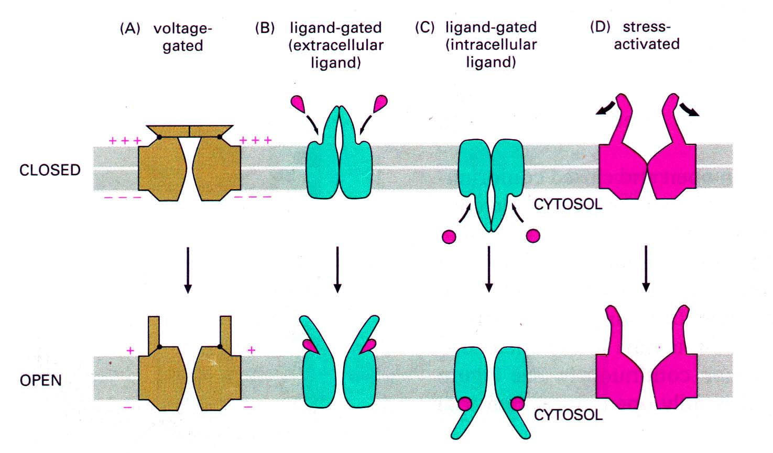

Slide 5
Ion channels
Specific channels for K⁺, Na⁺, Ca²⁺ and Cl⁻
Non selective channels for cations or anions
Composed of multiple subunits
Most K⁺ channels are tetramers
Ligand gated channels like acetylcholine has five subunits
Notes:
Each chanell exsist in multiple forms and are composed of identicle or similar subunits. ( voltage gated or cyclic nucleotide gated Na and Ca channels)
Channelopathies- caused by mutations in ion channelsMostly affect brain and muscles
Cause episodic paralysis or convulsions
Mostly affect brain and muscles
Cause episodic paralysis or convulsions

Slide 6
Transport proteins cont.
Carrier proteins
Bind ion, change configuration and move the ion down the concentration gradient ( from area of higher to lower concentration) or down the electrical gradient
Carrier proteins moving in chemical or electrical gradient – facilitated diffusion
No energy required

Slide 7
Transport proteins
Can be
Uniport
Transport one substance in one direction
Symport
Transport of more than one substance across the membrane together.
Antiport
Exchange of one substance for another

Slide 8
Membrane transport - Diffusion
Simple diffusion
Facilitated diffusion
Simple diffusion
Diffusion of lipid-soluble substances through the lipid bilayer.
Diffusion of water and other lipid-insoluble molecules through protein channels.

Slide 9
Simple diffusion
Occurs long the chemical or electrical gradient.
Not energy dependant.
Most protein channels are highly selective for transport of one or more specific ions or molecules.
Eg. Na⁺ channels
Many channels can be opened or closed by gates
Voltage gated channels
Ligand (Chemical) gated channels

Slide 10
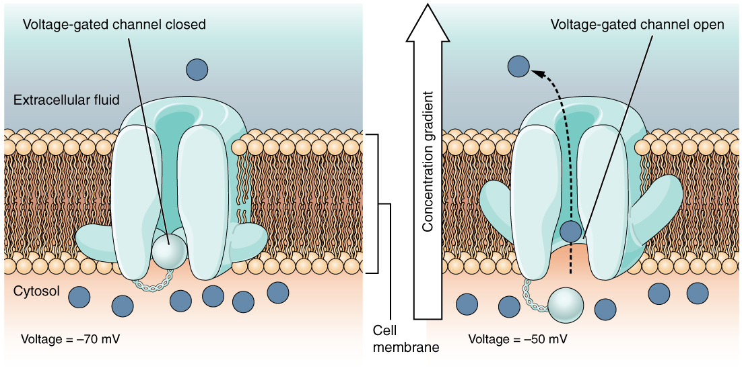
Voltage gating
The gate opens and closes in response to the changes in electrical potential across the cell membrane
Eg. Na⁺ channels open when inside of the cell become more positively charged compared to the outside. When inside become more negatively charged these channels remain tightly closed

Slide 11
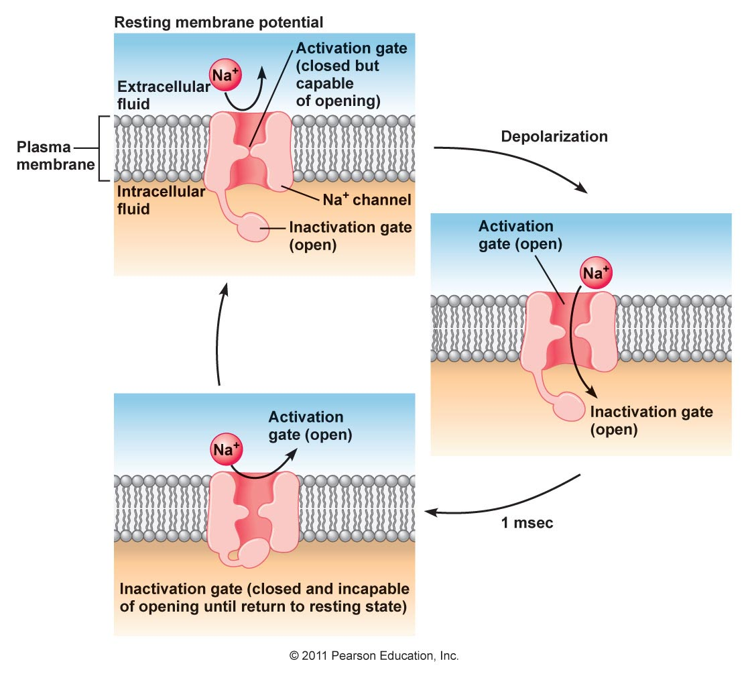

Slide 12
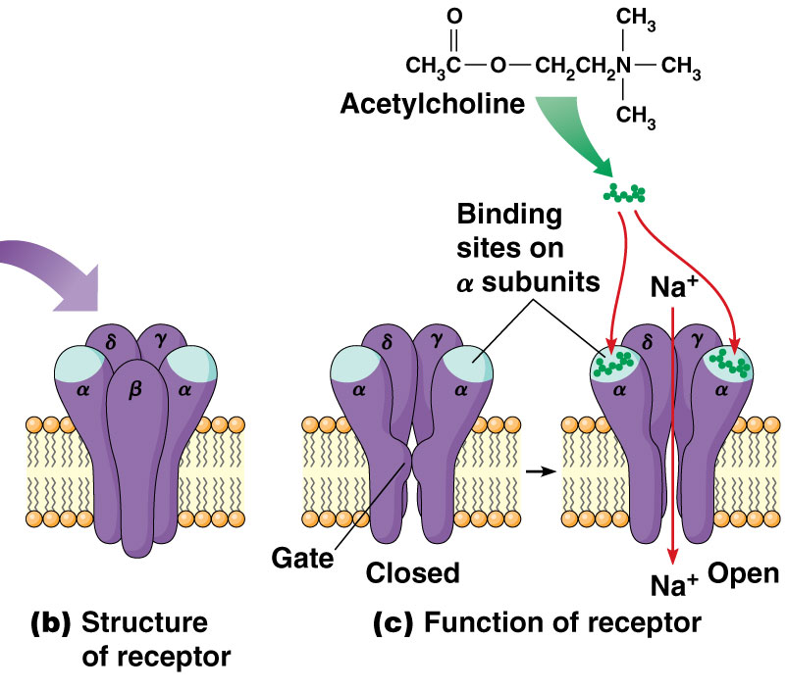
Ligand ( chemical gating)
Binding with a specific chemical substance opens the channel gate
Eg. Acetylcholine gated Na⁺ channels in neuromuscular junction

Slide 13
Osmosis
Transport water across selectively permeable membranes
When substance cannot cross the cell membrane water moves through water channels from lower concentration to higher concentration
The amount of pressure required exactly to stop osmosis is called as Osmotic pressure

Slide 14
Osmosis

Slide 15
Facilitated diffusion
Carrier mediated diffusion
Substances are transported by a specific carrier proteins
Occurs along the electrochemical gradient
Does not utilize energy
Rate of diffusion is saturable
Eg. Glucose transport into the cell

Slide 16
Vesicular transport

Slide 17
Vesiculaer transport - Exocytosis
Material for export are targeted to the cell membrane
Area of fusion break down
Ca²⁺ dependent process
Non-constitutive secretion-
Proteins from golgi apparatus enter the secretary granules
Prohormones mature to hormones
Exocytosis follows
Constitutive pathway – prompt transport of vesicles to the membrane
No or little processing or storage

Slide 18
Vesicular transport Endocytosis
Phagocytosis
Pinocytosis
Clathrin mediated endocytosis
Caveolae dependent uptake
Nonclathrin/noncaveolae endocytosis

Slide 19
Phagocytosis
Engulfing of material by cells
Bacteria, dead tissue, other microscopic particles being engulfed by polymorphonuclear leukocytes
Material on the cell membrane
Invagination
Pinch off of the invagination
Material in a vacuole
Membrane intact

Slide 20
Pinocytosis
Similer to phagocytosis
Smaller vesicles with substance in solution
Eg Macrophages
Clathrin mediated endocytosis
Occurs at places with membrane indentations where the protein clathrin accumulate
Internalize many receptors and liagands
Plays a major role in synaptic functions
Eg: Nerve growth factor, low density lipoproteins
Notes:
Exocytose and endocytosis coupling maintain the cell surface area at its normal size.

Slide 21
Active transport
Energy by hydrolysis of ATP
Many are ATPases
Eg: Na, K ATPase
H,K ATPase ( gastric mucosa and renal tubules)
Ca²⁺ ATPase pump
Proton ATPase

Slide 22
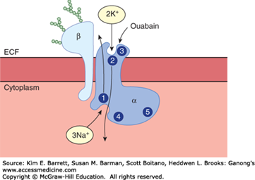
Na, K ATPase

Slide 23
Na, K ATPase
Major energy using process
Accounts for a large fraction of the basal metabolic rate.
Coupling ratio 3:2
Electrogenic pump
Present in all parts of the body
Hetrodimer ( alpha and beta subunits)
Alpha subunit transport the ions-
intracellular Na and ATP binding sites and a phosphorylation site.
Extracelluler K+ binding site
Beta subunit is a glycoprotein

Slide 24
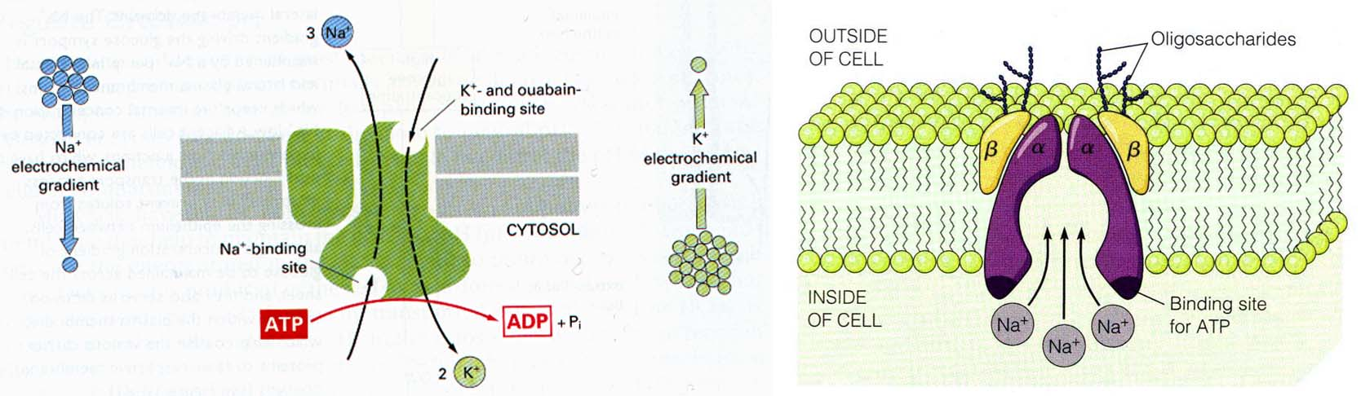
Na bind to alpha subunit
ATP also bind
Form ADP
Phosphate transferred to phosphorylation site
Change in protein configuration
Extrude Na+ into the ECF
Notes:
Regulation
Increased intracelluler Na+ - more Na+ pumped out
Second messengers ( c AMP, DAG)
Thyroid hormones increase formation of channels
Aldosterone – increase the number of pumps
Insulin increase pump activity
Dopamine in the kidney inhibits the pump by phosphorylation

Slide 25
Secondary active transport
Active transport of Na⁺ is coupled to the transport of other substances
On the luminal surface of SI mucosal membrane glucose is transported only if Na⁺ binds the protein
Both Na and glucose into the cell
Na concentration is maintained by Na , K ATPase.

Slide 26
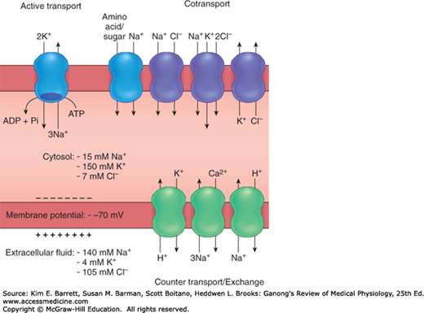

Slide 27
Home work
What are polarized epithelial cells?
Describe the transport across the capillary wall.
What is transcytosis?

